Slide 1
The Housing Platform
For Student Accommodation

Slide 2
Safely booking your accommodation abroad
HousingAnywhere works together with universities and institutions worldwide to help international talents easily and safely book their room abroad! How? By connecting them with outgoing exchange students, private landlords, host families, etc.
HOUSINGANYWHERE | 2

Slide 3
A secure booking system
All listings include clear descriptions of what is included in the price and what is not.
Your payment is securely held with us for protection when booking through our platform.
HousingAnywhere gives you 48 hours from your move in date to check that everything is as it was advertised, before transferring the rent to the advertiser.
If the room is not as advertised, you are 100% reimbursed.
HOUSINGANYWHERE | 3

Slide 4
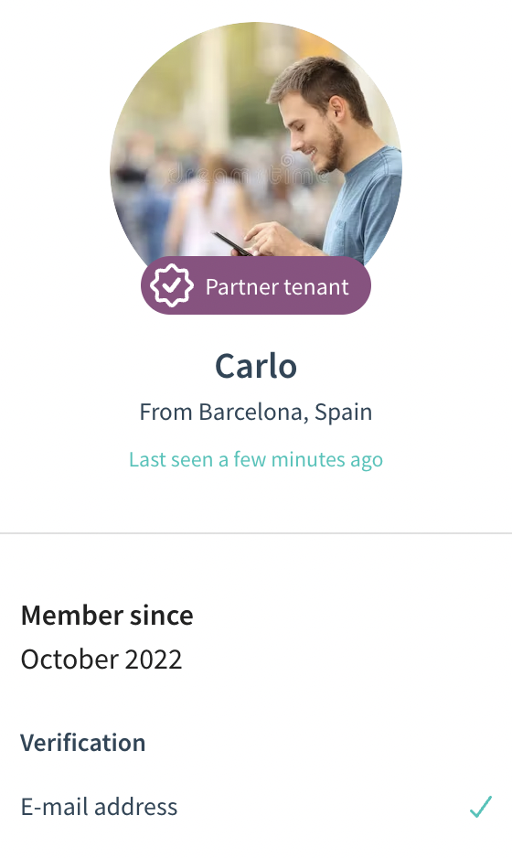
Priority Access
Members of all Partners are HousingAnywhere’s VIP Users!
Use the Priority Access Sign-up form provided by your Institution.
Receive a Partner Tenant Badge that certifies your reliability which will make you get accepted as tenants 7 times faster!
Have priority support through live-chat, telephone and via mail at vip@housinganywhere.com
HOUSINGANYWHERE | 4

Slide 5
Whom are you
renting from?
Outgoing exchange students Outgoing students who rent out their room during their semester abroad
Private landlords
Verified private landlords that are lawfully allowed to rent out their properties to students
Host families
Families or elderly interested in hosting a student
Housing operators
Agencies, Residencies, etc.
HOUSINGANYWHERE | 5

Slide 6
HousingAnywhere in your city
Publish your room on HousingAnywhere before leaving (make sure your landlord agrees!)
Receive requests by incoming students and trainees willing to rent your place (you will recognize them by the VIP Partner Tenant Badge)
Chat with potential candidates and accept the request of the tenant you like the most, without the need to organize viewings!
Avoid paying double rent and get back to your place when you return!
HOUSINGANYWHERE | 6

Slide 7
Extra Tips
Make the best out of HousingAnywhere. Get your room straight away!
All listings are transparent and come from verified advertisers. HousingAnywhere was created to allow everyone to book a room from ANYWHERE. You do not even have to visit the apartment in person.
Be safe! Be sure to book your accommodation through HousingAnywhere’s Secure Booking System. This way, you have the security of being fully reimbursed in case the room is not as advertised, and to get the first month’s rent in case of last minute, unjustified cancellations. Never share your contact details before having finalized the booking!
HOUSINGANYWHERE | 7

Slide 8
Extra Extra Tips
Search fast, search smart
Browse hundreds of properties in your city of choice. Save your favorites and set up search alerts so you don't miss your dream place!
Map it out
Get a true sense of place by pinpointing where you want to live in any city on our map. You can even use it as a search filter!
HOUSINGANYWHERE | 8

